Slide 1
Defending The Pass - Evaluating Defensive Ability Using Passing Data
Matt Cane – WinnersView / Hockey Graphs / Puck ++
Ryan Stimson – Hockey Graphs

Slide 2
Defence and passing
Why is defence so hard to evaluate?
  On defence players have to act as a unit -> Results are heavily influenced by teammates
  Data available from NHL is not very granular (only know shooter, location)
How can passing data help?
  Importance of passing has been established using tracking data in other sports
  Knowing sequence of events leading up to a shot can offer further clues about which players were defensively “responsible” for an event

Slide 3
The Passing Project
Who did it?
  Led by Ryan Stimson (co-ordination, training, data aggregation)
  Data tracked by volunteers
What was it?
  Tracking project to record the sequence of (up to 3) passes that preceded a shot attempt
  Tracked during the 2015-16 NHL season (approx. 565 games tracked)
Why did they do it?
  Hockey fans are crazy

Slide 4
What kind of passes were tracked?
From all the data collected, 7 basic pass types were created

Slide 5
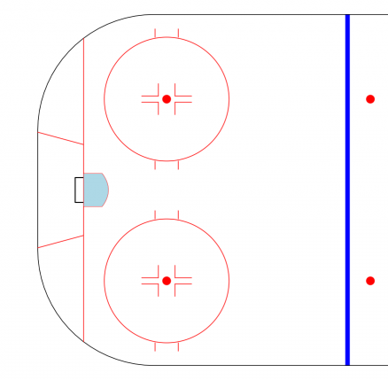
Rebounds
CSh% = 13.5%
Shot
G
Shots taken from inside the home plate area following another shot from a pass.
Shots taken from inside the home plate area following another shot
Shot

Slide 6
Odd-Man
CSh% = 16.9%
Zach Hyman
DEF.
Pass
Shots taken off of passes where the attacking team outnumbered the defending team upon entry into the offensive zone.
Shot

Slide 7
Point
CSh% = 1.6%
Pass
Shot
Shots from passes within the offensive zone back to a teammate at the blue line.

Slide 8
Royal Road
CSh% = 14.6%
Pass
Shots from passes crossing a line from the center of one net to the other that did not meet one of the above criteria.
Shot

Slide 9
Behind the Net
CSh% = 6.1%
Pass
Shot
Shots from passes originating from behind the icing line that did not meet one of the above criteria.

Slide 10
Center Lane
CSh% = 3.8%
Shots from passes originating from between the faceoff dots that did not meet one of the above criteria.
Pass
Shot

Slide 11
Outer Lane
CSh% = 2.9%
Shots from passes originating from outside the faceoff dots that did not meet one of the above criteria.
Shot
Pass

Slide 12
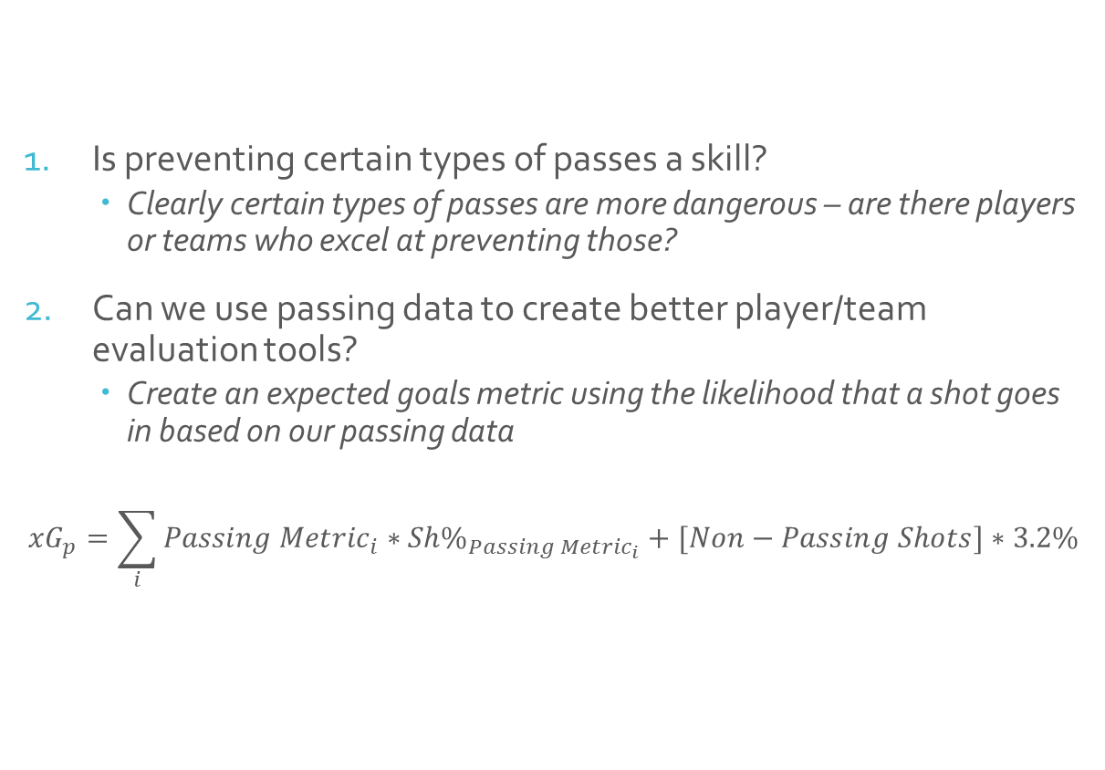
Using passing data to evaluate defence
Is preventing certain types of passes a skill?
  Clearly certain types of passes are more dangerous – are there players or teams who excel at preventing those?
Can we use passing data to create better player/team evaluation tools?
  Create an expected goals metric using the likelihood that a shot goes in based on our passing data
$${xG}_{p}=\sum_{i}{{Passing Metric}_{i}∗{Sh\%}_{{Passing Metric}_{i}}}+[Non−Passing Shots]∗3.2\%$$

Slide 13
Team Level Analysis
Team level passing metrics are repeatable
  Systems/tactics can influence what type of passes teams allow
Passing Expected Goals is more predictive than existing metrics
  Better to know pre-shot puck movement than shot location
Passing data can help evaluate team level strategies and tactical approaches
Notes:
For example, the 2015-2016 Florida Panthers employed an aggressive, half-ice overload system which exerted a significant amount of pressure on their opponents in all three zones of the ice. This system allowed fewer opportunities for their opponents to generate extended passing sequences, and their rate of pass-assisted shots against per 60 minutes of 5-on-5 play was the lowest of all teams in games tracked to date.
In contrast, the 2015-2016 Colorado Avalanche were much more passive and did not allow players to fill in for each other, instead relying on a strict man-to-man coverage system. This system was frequently exposed by their opponents, resulting in the Avalanche allowing the second most Royal Road Shots Against per 60, and the fourth most Behind-The-Net shots against per 60. The Avs player-to-player marking frequently allowed their opponents’ stars to lose their defenders and create opportunities to make dangerous passes and create high quality scoring chances.

Slide 14
Team Level Analysis
Aggressive defensive strategies help prevent dangerous passes
2015-16 Panthers: Aggressive, half-ice overload system
  Lowest pass-assisted shots allowed /60
2015-16 Avs: Passive, strict man-to-man coverage
  Most Royal Road Shots Allowed/60, 4th Most Behind The Net SA/60
Notes:
For example, the 2015-2016 Florida Panthers employed an aggressive, half-ice overload system which exerted a significant amount of pressure on their opponents in all three zones of the ice. This system allowed fewer opportunities for their opponents to generate extended passing sequences, and their rate of pass-assisted shots against per 60 minutes of 5-on-5 play was the lowest of all teams in games tracked to date.
In contrast, the 2015-2016 Colorado Avalanche were much more passive and did not allow players to fill in for each other, instead relying on a strict man-to-man coverage system. This system was frequently exposed by their opponents, resulting in the Avalanche allowing the second most Royal Road Shots Against per 60, and the fourth most Behind-The-Net shots against per 60. The Avs player-to-player marking frequently allowed their opponents’ stars to lose their defenders and create opportunities to make dangerous passes and create high quality scoring chances.

Slide 15
Player Level Analysis
Passing defence is repeatable at the player level
  All metrics but Royal Road Against/60 significant in split-half test
For defencemen, our passing expected goals metric is more predictive than existing metrics
  For forwards, it is a significant predictor, though slightly less predictive than location based expected goals
Player level passing metrics are somewhat independent (weak correlation between metrics)
  Passing data can help identify players with particular skillsets
  Hampus Lindholm:
    Near the top of the league in odd-man attempts against
    Just outside the bottom 10% in behind-the-net passes
  Can help fill gaps in a teams defensive lineup
Notes:
#1 defenceman in last year’s passing expected goals sample – Josh Manson

Slide 16
Players People Love (Or Love To Hate)
Player | TOI | CA60 | Passing xGA60
Patrick Wiercioch | 320 | 55.1 | 2.31 (120)
Cody Ceci | 416 | 57.6 | 2.37 (141)
Marc Methot | 412 | 59.5 | 2.39 (147)
Erik Karlsson | 604 | 57.0 | 2.44 (155)
Mark Borowiecki | 246 | 61.9 | 2.55 (171)
Chris Wideman | 283 | 65.8 | 2.65 (181)
Jared Cowen | 200 | 63.8 | 2.65 (183)
Notes:
Karlsson 2nd best by CA60, but middle of the pack by Passing xGA60
Offensive defencemen tend to have higher Passing xGA – more rush attempts, odd-man, etc. LA blueline almost all perform worse, Shattenkirk is much worse too.
Dennis Seidenberg is in quarter of league for CA60, top 10% for passing xGA

Slide 17
Players People Love (Or Love To Hate) II
Player | TOI | GA60 | Passing xGA60
Frank Corrado | 253 | 2.37 | 1.93 (18)
Jake Gardiner | 708 | 1.94 | 2.05 (50)
Martin Marincin | 440 | 1.91 | 2.06 (56)
Roman Polak | 462 | 1.16 | 2.15 (73)
Dion Phaneuf | 482 | 1.74 | 2.26 (101)
Matt Hunwick | 610 | 2.46 | 2.42 (153)
Morgan Rielly | 768 | 2.34 | 2.43 (154)
Notes:
Dearly departed Frankie Corrado
Phaneuf and Polak – both decent by passing xGA, but had more trade value due to v low actual ga60

Slide 18
Conclusions
Pre-shot puck movement has a significant impact on the likelihood of a shot attempt becoming a goal
Passing data can be used to evaluate defensive tactics or identify players who may help fill specific defensive needs
Future Work:
  Quality of Competition with passing data
  Impact of zone starts on pass defence
For more of our work:
  Winnersview.com
  Hockey-graphs.com
  @Cane_Matt
  @RK_Stimp

Slide 19
Thank you!
Brian Franken | Stephen Leithwood | Mike Little
Kevin Winstanley | Rose Ford | Jacob Reid
Krista Asadorian | Shawn Ferris | Derek Fetters
Alan Wells | Luke Brennan | James Kierans
Jesse Severe | Megan Kim | Jeremy Davis
Sean Mah | Scott Edward | Sara Garcia
Jeremy Crowe | Nick Anandranistakis | Benoit Roy
Shayna Goldman | John Pullega | Jason Reynolds
Thomas Dianora | Sean Wetzell | Jessica Fong
Michaela Kovarova | Quinn Walker | Bill Jennings
Erik den Haan | Shane O’Donnell | Emma Kaiser
Johnny Humphrey | Dan Lobster | Some guy named Ryan
Thank you to all the trackers who made this project possible!

