Slide 1
Predicting Free Agent Salaries with Traditional and Advanced Metrics
Matt Cane
@Cane_Matt
puckplusplus.com
hockey-graphs.com

Slide 2
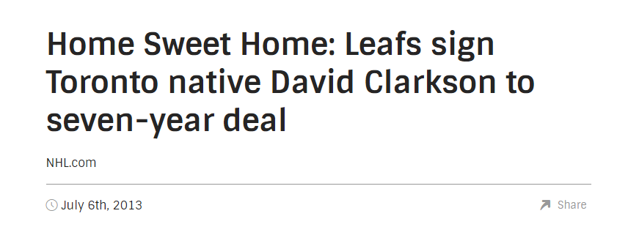
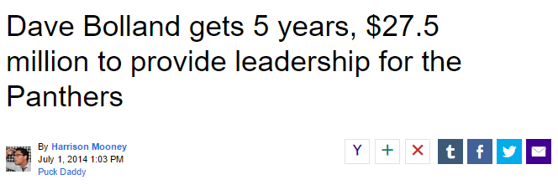
Predicting Salaries: Why?
Don’t need stats or any models to know these were bad deals
Statistical model can provide a sanity check
  Knowing what we expect a player to cost can help teams avoid big mistakes

Slide 3
Predicting Salaries: Why?
Teams have limited resources to identify and pursue free agents
  Figuring out who may fit into your budget early is beneficial
Useful to players to know what statistically similar players have been paid
  Don’t want to leave money on the table
Can help identify teams who overpay vs. market, or find cheap free agent talent
Can help identify players whose price (dollars) is different from their value (wins)
Bonus: Provides something for strangers on the internet to yell at you about when you suggest that their favourite player is overpaid

Slide 4
Basic Attempt: Linear Model
Predict UFA Salaries with Basic Counting Stats
Provided relatively good predictions
  Forwards R^2 = 0.76
  Defence R^2 = 0.74
Problem with linear model
  Negative Predicted Salaries
  Can’t force Colton Orr to pay $275K to play in the NHL

Slide 5
Better Method: Beta Regression
Player salaries are constrained to a set minimum/maximum value based on the CBA and Salary Cap
Represent each contract as a percentage:
  Salary Percent = (Salary – Minimum)/(Maximum – Minimum)
Each players salary is now represented as a number between 0 and 1
Use Beta Regression to create models that translate past results into predicted salary percentages
  Beta Regression restricts predictions to between 0 and 1
  Gives flexibility in structure of prediction

Slide 6
Two Methods: Basic and Advanced Stats
Basic Stats (Counting Stats):
  Represent the market price
  Games Played, Total TOI, EV Goals, Assists, PP Points, Age, SH/PP TOI, Penalties Taken, Hits
  Contract Type (Full UFA, Partial RFA/Partial UFA, RFA Bridge)
Advanced Stats
  Represent the “true” value (assuming past wins are a good proxy for future wins)
  WAR-On-Ice WAR
  Total TOI
  Contract Type (Full UFA, Partial RFA/Partial UFA, RFA Bridge)
Using previous 3 years of data (all data from War On Ice) to predict Salary Percent
Model Forwards and Defencemen Separately
Exclude players with salary < 1MM and Entry Level Contracts

Slide 7
Findings
Raw values are better predictors than rate stats
  Raw values capture information about injuries, playing time, benchings, etc.
Recent stats are more important than past stats
Traditional metrics are better predictors than WAR
Position | Traditional Model R^2 | WAR Model R^2
Forwards | 0.73 | 0.57
Defencemen | 0.70 | 0.53

Slide 8
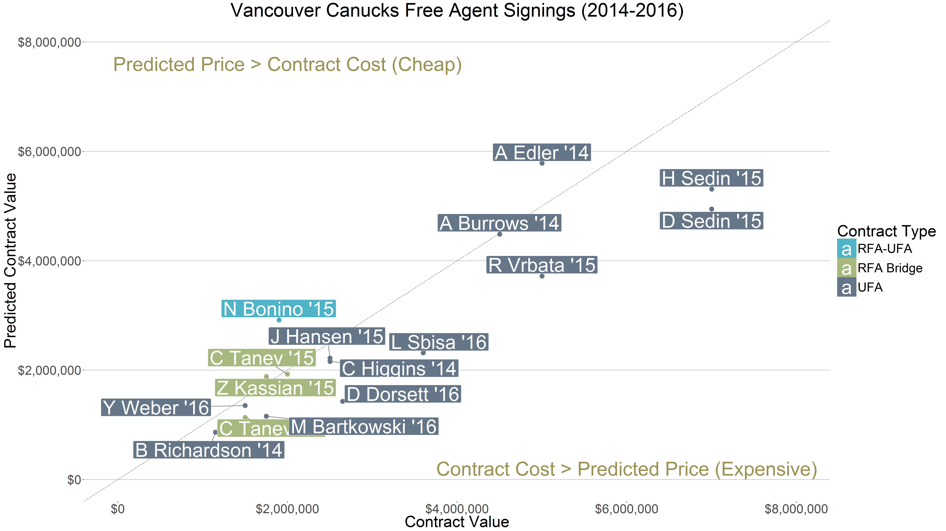
Application: Evaluating GM’s Signings
Compare predicted price to actual contract to identify players who may have been over/underpaid

Slide 9
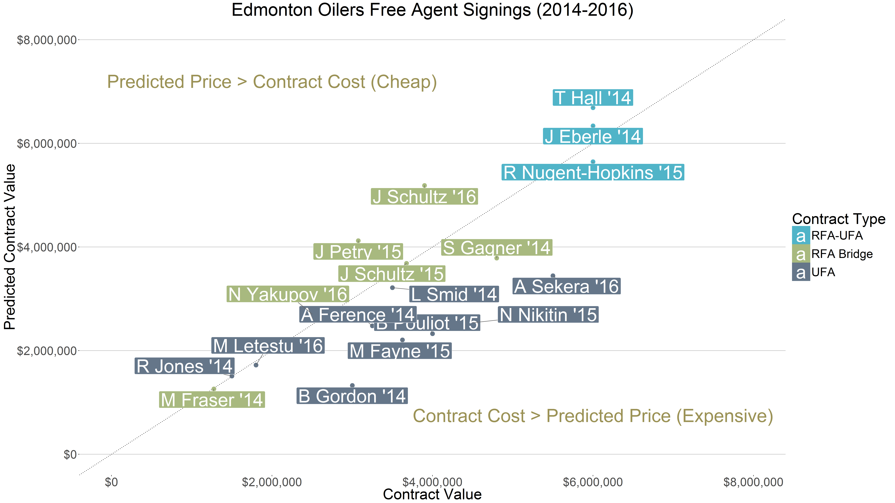
Application: Evaluating GM’s Signings
Oilers signed their RFAs to reasonable deals (Bridge/UFA-RFA); UFAs have been paid above market value

Slide 10
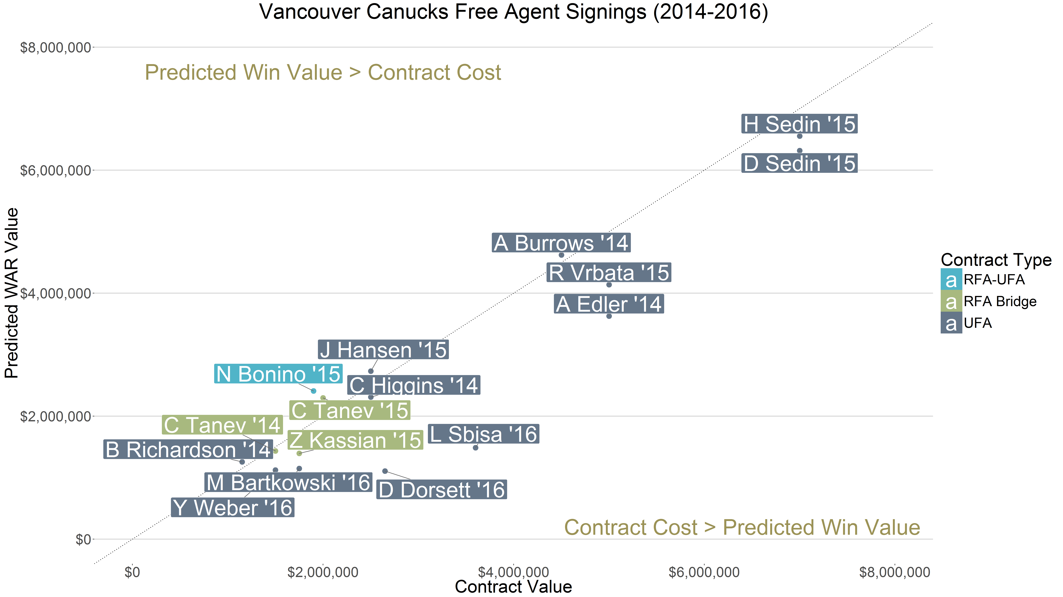
Application: Evaluating GM’s “Talent Identification”
Compare WAR value to actual contract value to see if GMs pay for overall contribution in wins

Slide 11
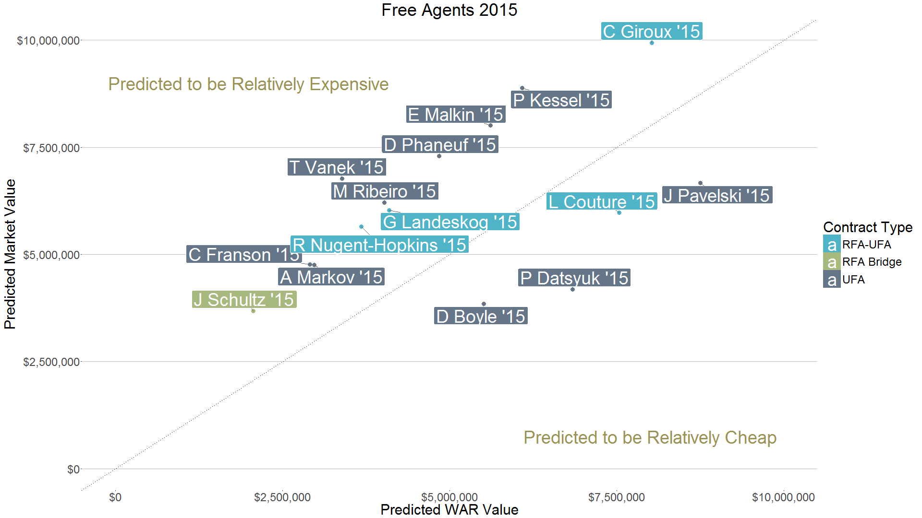
Application: Finding Relatively “Cheap” Free Agents
Predictions can help identify players whose projected Win Value is more than their Market Value

Slide 12
Future Enhancements
Incorporate size of market in a given year
  When there are few options at a position, players should get higher salaries
Incorporate past salary and buyouts
  Players with big contracts before may be more likely to get big contracts after
  Buyouts severely depress market price

Slide 13
For More Information
Twitter: @Cane_Matt
E-Mail: puckplusplus@gmail.com
For copies of these slides, graphs for each team, and initial predictions for upcoming free agents please see:
puckplusplus.com/contracts

